Slide 1


Advisory Board sessions with the UK’s leading venture builder
Access to in-house services such as legal, HR, accounting & tax advisory
Access to a network of investors
Programme of regular seminars and events.
A ready-made business network
Shared spaces, designed for collaboration and innovation
Dedicated desks
Unique event spaces
Super fast internet, wifi and printing.
Tech-enabled meeting rooms
Private café
Serviced reception
Onsite Community Manager
Private office and co-working space
Tweet us @AccelerateNttm
Find out more: hello@AcceleratePlaces.com
Wi-Fi
network: APLACES
password: Work100%Better

Slide 2

Developing an AI that can learn to play the classic game of Tic-Tac-Toe
By Dr Alan Faulkner
Code is available at: https://github.com/AlanFaulkner/NottinghamAIMeetup

Slide 3





Introduction
Google software teaches itself to play 'SPACE INVADERS': Artificial intelligence program learns how to play without ever been shown the instructions
– The Daily Mail

Slide 4



What is the job of a neural network?
It’s a way to approximate a function (f(x)) that maps some input(s) to some output(s).
output
Yes : 0.98
No : 0.1
I don’t know : 0.2
Yes : 0.03
No : 0.89
I don’t know : 0.01
Yes : 0.3
No : 0.47
I don’t know : 0.78
Categorising
Is this a cat?

Slide 5
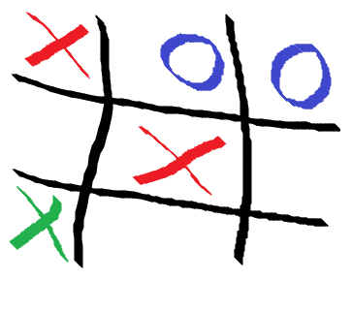
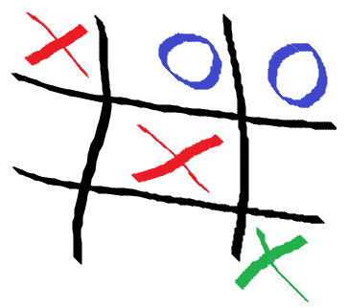
What is the job of a neural network?
It’s a way to approximate a function (f(x)) that maps some input(s) to some output(s).
Output = 0.672
Output = 0.999
Data evaluation
What is the chance that this is a winning move?

Slide 6
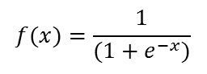
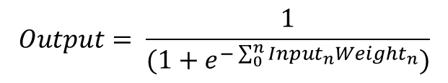
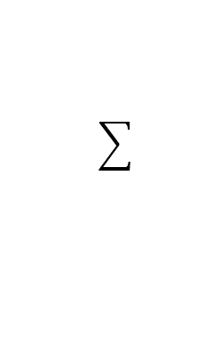
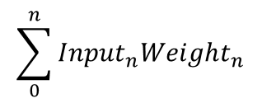
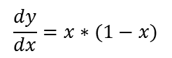
The architecture of a neural network
Neuron (Perceptron)
Sigmoid Step Function
Input 1
Output
Input 2
Input 3
Bias
$$f(x)=\frac{1}{({1+e}^{−x})}$$
$$\sum_{0}^{n}{{Input}_{n}{Weight}_{n}}$$
$$\frac{dy}{dx}=x∗(1−x)$$
$$Output= \frac{1}{(1+e^{−\sum_{0}^{n}{{Input}_{n}{Weight}_{n}}})}$$
Overall we get:

Slide 7
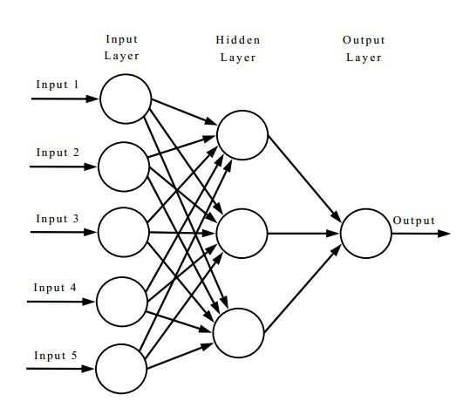
The architecture of a neural network
Reproduced from
http://tex.stackexchange.com/questions/132444/diagram-of-an-artificial-neural-network

Slide 8
Back propagation algorithm
DO {
For each Input in InputData {
Calculate Network Output
Calculate Neuron Error (Target – Output)
Calculate Network Error
Update Weights
}
Epoch++;
}
WHILE (Epoch < Max no. of iterations && Network error > target error)
Assumptions:
We are using supervised leaning – we have known output.
stochastic training – weights are updated after each set of input data is evaluated.
The network has only one output neuron.

Slide 9
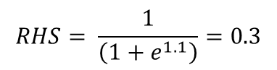
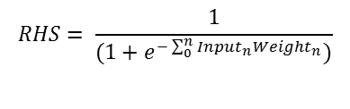
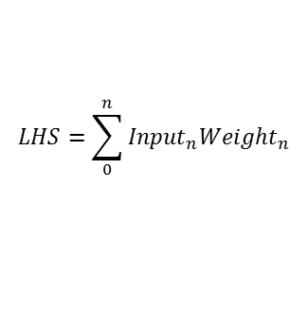
Step 1: Feed-Forward
Input Layer
Hidden Layer
Output Layer
W₁ 0.5
-1.1
0.3
W₇ 1.3
1
W₂ 1.3
B₁ 0.1
W₈ -0.1
W₄ -1.7
W₃ -2.3
1
W₅ 0.2
B₂ 0.1
W₉ -1.1
B₄ 0.1
W₆ 0.6
B₃ 0.1
Remember:
$$LHS=1∗0.5+1∗−1.7+0.1=−1.1$$
$$LHS=\sum_{0}^{n}{{Input}_{n}{Weight}_{n}}$$
-1.1
0.3
$$RHS= \frac{1}{\left(1+e^{1.1}\right)}=0.3$$
$$RHS= \frac{1}{(1+e^{−\sum_{0}^{n}{{Input}_{n}{Weight}_{n}}})}$$

Slide 10
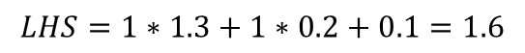
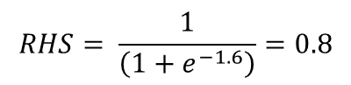
Step 1: Feed-Forward
Input Layer
Hidden Layer
Output Layer
W₁ 0.5
-1.1
0.3
W₇ 1.3
1
W₂ 1.3
B₁ 0.1
W₈ -0.1
1.6
0.8
W₄ -1.7
W₃ -2.3
1
W₅ 0.2
B₂ 0.1
W₉ -1.1
B₄ 0.1
W₆ 0.6
B₃ 0.1
Remember:
$$LHS=1∗1.3+1∗0.2+0.1=1.6$$
$$LHS=\sum_{0}^{n}{{Input}_{n}{Weight}_{n}}$$
1.6
0.8
$$RHS= \frac{1}{\left(1+e^{−1.6}\right)}=0.8$$
$$RHS= \frac{1}{(1+e^{−\sum_{0}^{n}{{Input}_{n}{Weight}_{n}}})}$$

Slide 11
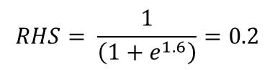
Step 1: Feed-Forward
Input Layer
Hidden Layer
Output Layer
W₁ 0.5
-1.1
0.3
W₇ 1.3
1
W₂ 1.3
B₁ 0.1
W₈ -0.1
1.6
0.8
W₄ -1.7
W₃ -2.3
1
W₅ 0.2
B₂ 0.1
W₉ -1.1
B₄ 0.1
W₆ 0.6
-1.6
0.2
B₃ 0.1
Remember:
$$LHS=1∗−2.3+1∗0.6+0.1=−1.6$$
$$LHS=\sum_{0}^{n}{{Input}_{n}{Weight}_{n}}$$
-1.6
0.2
$$RHS= \frac{1}{\left(1+e^{1.6}\right)}=0.2$$
$$RHS= \frac{1}{(1+e^{−\sum_{0}^{n}{{Input}_{n}{Weight}_{n}}})}$$

Slide 12
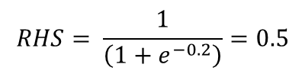
Step 1: Feed-Forward
Input Layer
Hidden Layer
Output Layer
W₁ 0.5
-1.1
0.3
W₇ 1.3
1
W₂ 1.3
B₁ 0.1
W₈ -0.1
0.2
0.5
1.6
0.8
W₄ -1.7
W₃ -2.3
1
W₅ 0.2
B₂ 0.1
W₉ -1.1
B₄ 0.1
W₆ 0.6
-1.6
0.2
B₃ 0.1
Remember:
$$LHS=0.3∗1.3+0.8∗−0.1+0.2∗−1.1+0.1=0.2$$
$$LHS=\sum_{0}^{n}{{Input}_{n}{Weight}_{n}}$$
-1.6
0.2
$$RHS= \frac{1}{\left(1+e^{−0.2}\right)}=0.5$$
$$RHS= \frac{1}{(1+e^{−\sum_{0}^{n}{{Input}_{n}{Weight}_{n}}})}$$

Slide 13
Back propagation algorithm
DO {
For each Input in InputData {
Calculate Network Output
Calculate Neuron Error (Target – Output)
Calculate Network Error
Update Weights
}
Epoch++;
}
WHILE (Epoch < Max no. of iterations && Network error > target error)
Assumptions:
We are using supervised leaning – we have known output.
stochastic training – weights are updated after each set of input data is evaluated.
The network has only one output neuron.

Slide 14
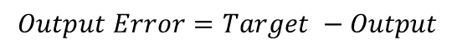
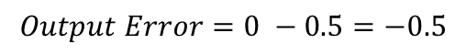
Step 2: Calculate output error
Input Layer
Hidden Layer
Output Layer
W₁ 0.5
-1.1
0.3
W₇ 1.3
1
Target
0
W₂ 1.3
B₁ 0.1
W₈ -0.1
0.2
0.5
1.6
0.8
W₄ -1.7
W₃ -2.3
1
W₅ 0.2
B₂ 0.1
W₉ -1.1
B₄ 0.1
W₆ 0.6
-1.6
0.2
B₃ 0.1
We only have one neuron in our output layer. If we had multiple output neurons we would need to calculate the error for each one.
Note:
$$Output Error=Target −Output$$
$$Output Error=0 −0.5=−0.5$$

Slide 15
Back propagation algorithm
DO {
For each Input in InputData {
Calculate Network Output
Calculate Neuron Error (Target – Output)
Calculate Network Error
Update Weights
}
Epoch++;
}
WHILE (Epoch < Max no. of iterations && Network error > target error)
Assumptions:
We are using supervised leaning – we have known output.
stochastic training – weights are updated after each set of input data is evaluated.
The network has only one output neuron.

Slide 16
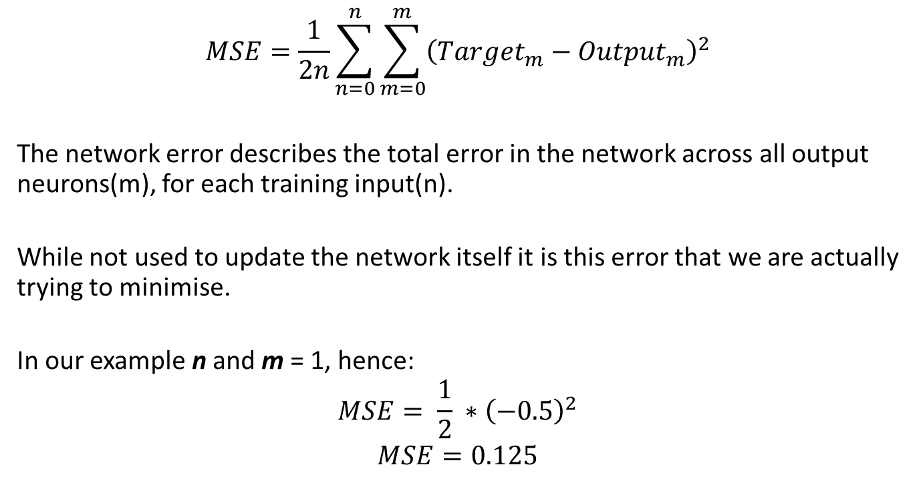
Step 3: Calculate Network Error
$$MSE=\frac{1}{2n}\sum_{n=0}^{n}{\sum_{m=0}^{m}{{\left({Target}_{m}−{Output}_{m}\right)}^{2}}}$$
The network error describes the total error in the network across all output neurons(m), for each training input(n).
While not used to update the network itself it is this error that we are actually trying to minimise.
In our example n and m = 1, hence:
$$MSE= \frac{1}{2} ∗{\left(−0.5\right)}^{2}$$
$$MSE=0.125$$
Note:
Other means of calculating the network error exist these include root mean squared error and cross entropy. These are referred to as loss functions.

Slide 17
Back propagation algorithm
DO {
For each Input in InputData {
Calculate Network Output
Calculate Neuron Error (Target – Output)
Calculate Network Error
Update Weights
}
Epoch++;
}
WHILE (Epoch < Max no. of iterations && Network error > target error)
Assumptions:
We are using supervised leaning – we have known output.
stochastic training – weights are updated after each set of input data is evaluated.
The network has only one output neuron.

Slide 18
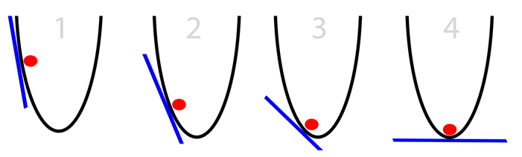
Gradient Descent
Oversimplified Gradient Descent:
Calculate slope at current position
If slope is negative, move right
If slope is positive, move left
(Repeat until slope == 0)

Slide 19
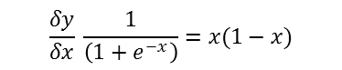
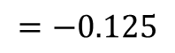
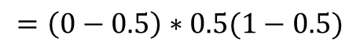
Step 4: Weight updates – Output layer
Output Layer
W₇ 1.3
Target
W₈ -0.1
0.5
0
W₉ -1.1
B₄ 0.1
$$Neuron Error=\left(Target−output\right)∗output(1−output)$$
Remember:
$$=\left(0−0.5\right)∗0.5(1−0.5)$$
$$\frac{δy}{δx} \frac{1}{\left(1+e^{−x}\right)}=x(1−x)$$
$$=−0.125$$

Slide 20
Step 4: Weight updates – Output layer
Output Layer
W₇ 1.3
Target
W₈ -0.1
0.5
0
W₉ -1.1
B₄ 0.1
Err = -0.125
$$Weight update=Weight ∗Err ∗Learning rate$$
Note:
$${∆W}_{7}=1.3∗−0.125∗0.001=−0.0001625$$
Learning rate is a ‘hyper parameter’. Such parameters are determined by the user for a given problem.

Slide 21
Step 4: Weight updates – Output layer
Output Layer
W₇ 1.2998375
Target
W₈ -0.1
0.5
0
W₉ -1.1
B₄ 0.1
Err = -0.125
$$Weight update=Weight ∗Err ∗Learning rate$$
Note:
$${∆W}_{7}=1.3∗−0.125∗0.001=−0.0001625$$
Learning rate is a ‘hyper parameter’. Such parameters are determined by the user for a given problem.
$$new Weight =Weight+Weight update$$
$W_{7}=1.3+−0.0001625=1.2998375$

Slide 22
Step 4: Weight updates – Output layer
Output Layer
W₇ 1.2998375
Target
W₈ -0.1000125
0.5
0
W₉ -1.1
B₄ 0.1
Err = -0.125
$$Weight update=Weight ∗Err ∗Learning rate$$
Note:
$${∆W}_{8}=0.1∗−0.125∗0.001=−0.0000125$$
Learning rate is a ‘hyper parameter’. Such parameters are determined by the user for a given problem.
$$new Weight =Weight+Weight update$$
$W_{8}=−0.1+−0.0000125=−0.1000125$

Slide 23
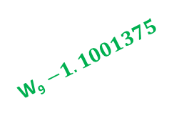
Step 4: Weight updates – Output layer
Output Layer
W₇ 1.2998375
Target
W₈ -0.1000125
0.5
0
W₉ $−1.1001375$
B₄ 0.1
Err = -0.125
$$Weight update=Weight ∗Err ∗Learning rate$$
Note:
$${∆W}_{9}=−1.1∗−0.125∗0.001=−0.0001375$$
Learning rate is a ‘hyper parameter’. Such parameters are determined by the user for a given problem.
$$new Weight =Weight+Weight update$$
$W_{9}=−1.1+−0.0001375=−1.1001375$

Slide 24
Step 4: Weight updates – Output layer
Output Layer
W₇ 1.2998375
Target
W₈ -0.1000125
0.5
0
W₉ $−1.1001375$
B₄ 0.0999875
Err = -0.125
$$Weight update=Weight ∗Err ∗Learning rate$$
Note:
$${∆B}_{4}=0.1∗−0.125∗0.001=−0.0000125$$
Learning rate is a ‘hyper parameter’. Such parameters are determined by the user for a given problem.
$$new Weight =Weight+Weight update$$
$B_{4}=0.1+−0.0000125=0.0999875$

Slide 25
Step 4: Weight updates – Hidden layer
Hidden Layer
Output Layer
W₈ 1.2998375
Err = -0.125
B₁ 0.1
Output Error = (-0.125*1.2998375)

Slide 26
Step 4: Weight updates – Hidden layer
Hidden Layer
Output Layer
W₈ 1.2998375
W_{i} 0.3
Err = -0.125
B₁ 0.1
Err = 0. 25
Output Error = (-0.125*1.2998375)+(0.3*0.25)

Slide 27
Step 4: Weight updates – Hidden layer
Hidden Layer
Output Layer
W₈ 1.2998375
-1.1
0.3
Err = -0.125
B₁ 0.1
Output Error = (-0.125*1.2998375) = -0.1624796875
Neuron Error = Output Error * Output(1-Output)
Remember:
Neuron Error = -0.162 * 0.3(1-0.3) = -0.034120734
$$\frac{δy}{δx} \frac{1}{\left(1+e^{−x}\right)}=x(1−x)$$

Slide 28
Step 4: Weight updates – Hidden layer
W₁ 0.5
W₄ -1.7
B₁ 0.1
Err = -0.034
$$Weight update=Weight ∗Err ∗Learning rate$$
$${∆W}_{1}=0.5∗−0.034∗0.001=−0.0000017$$
$${∆W}_{4}=−1.7∗−0.034∗0.001=−0.0000058$$
$${∆B}_{1}=0.1∗−0.034∗0.001=−0.0000006$$
Note:
Learning rate is a ‘hyper parameter’. Such parameters are determined by the user for a given problem.
Weights for all hidden neurons are calculated in same manner
$$new Weight =Weight+Weight update$$
$W_{1}=0.5+−0.0000017=0.4999983$
$W_{4}=−1.7+−0.0000058=−1.7000058$
$B_{1}=0.1+−0.0000006=0.0999966$

Slide 29
Back propagation algorithm
DO {
For each Input in InputData {
Calculate Network Output
Calculate Neuron Error (Target – Output)
Calculate Network Error
Update Weights
}
Epoch++;
}
WHILE (Epoch < Max no. of iterations && Network error > target error)
Assumptions:
We are using supervised leaning – we have known output.
stochastic training – weights are updated after each set of input data is evaluated.
The network has only one output neuron.

Slide 30

An alternate training scheme
Stochastic gradient descent (also called online training).
For each item in data set {
Calculate Output for given training example;
Calculate Weight Update;
Update weights;
}
XOR
A | B | Out
1 | 1 | 0
1 | 0 | 1
0 | 1 | 1
0 | 0 | 0
Batch gradient descent.
Final Weight Update = 0;
For each item in data set {
Calculate Output for given training example;
Final Weight Update += Calculate weight update;
}
Update weights;

Slide 31
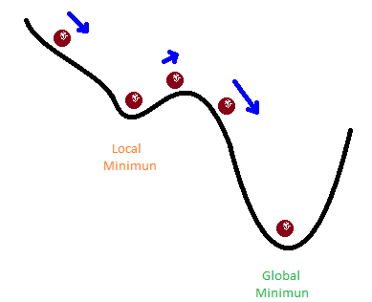
A simple improvement
Several improvements to the back propagation algorithm have been made. The simplest is the inclusion of the idea of momentum.
Note:
Momentum factor is a ‘hyper parameter’. Such parameters are determined by the user for a given problem.
$$new Weight =Weight+Weight Update+Momentum$$
$$Momentum =Previous Weight Update ∗Momentum factor$$
http://sebastianruder.com/optimizing-gradient-descent/

Slide 32
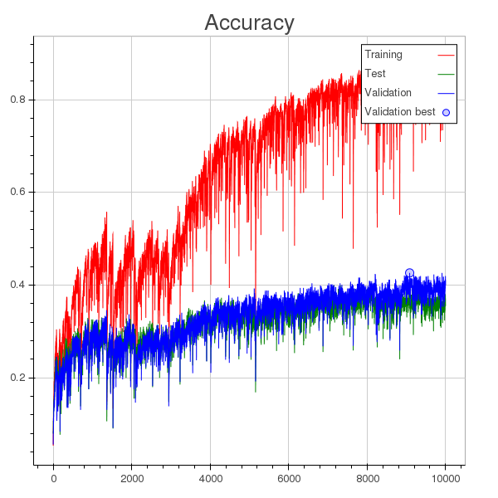
Training issues
Over fitting
The network learns to recognise the training data but performs badly on none training data.
Split the data set into two; a larger training set and a smaller validation set.
A well trained network should show similar accuracy for both training and validation set
Over fitting can be reduced though carful selection of training data.
Graph from http://stats.stackexchange.com/questions/208763/classification-accuracy-increasing-while-overfitting

Slide 33
Summary
Neural networks are designed to find a function that maps a given set of inputs to an output.
This is done by employing gradient descent and back propagation.
Several hyper parameters (training rate, momentum and batch size), have to be decided by the user and optimised for each given problem
The success of a network is highly dependant on having good input data

Slide 34
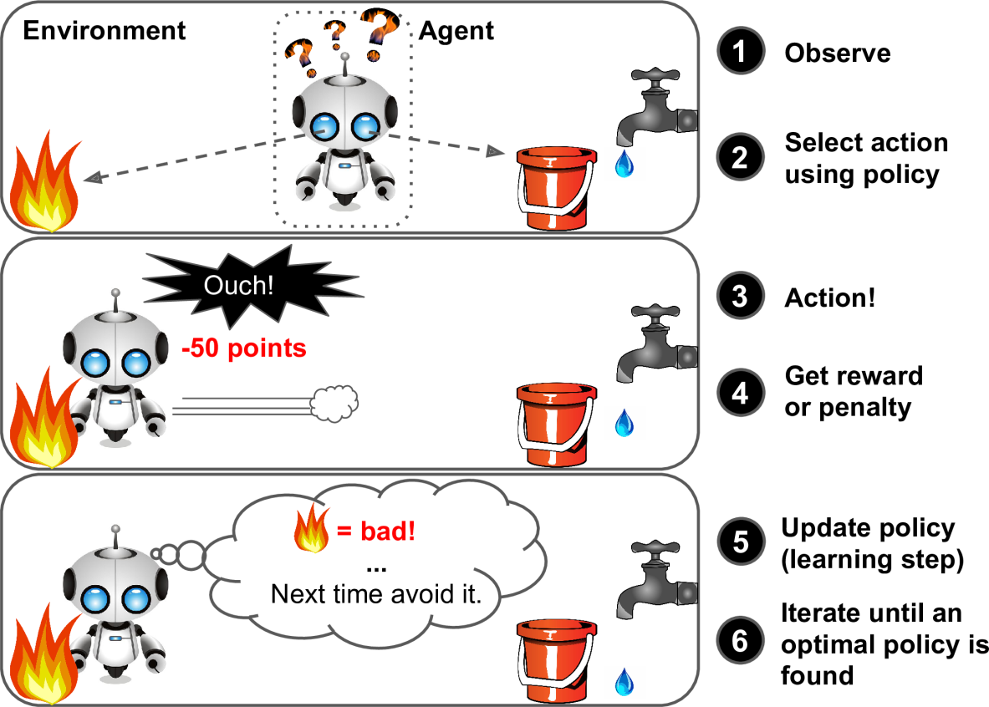
Q-Learning
Form of model free reinforcement learning
Means it can easily be applied to any problem
Image from https://www.safaribooksonline.com/library/view/hands-on-machine-learning/9781491962282/ch01.html

Slide 35

The N-bandit problem
The premise is that there are n one armed bandits each with an unknown win rate how do you maximise your chances of winning?

Slide 36

The N-bandit problem
Observe
The current known pay out for each machine
Select
Choose machine
Action
Play 10 games on selected machine
Reward
The pay-out from playing on a given machine
Update Pay-outs
$$Q\left(s_{t}a_{t}\right)←Q\left(s_{t}a_{t}\right)+α(r_{t}+γ∗maxQ\left(s_{t+1}a_{t}\right)−Q\left(s_{t}a_{t}\right))$$
where
α = Learning rate
γ = Discount rate
New Value
Old Value
Reward
Estimate of future reward
Old Value

Slide 37
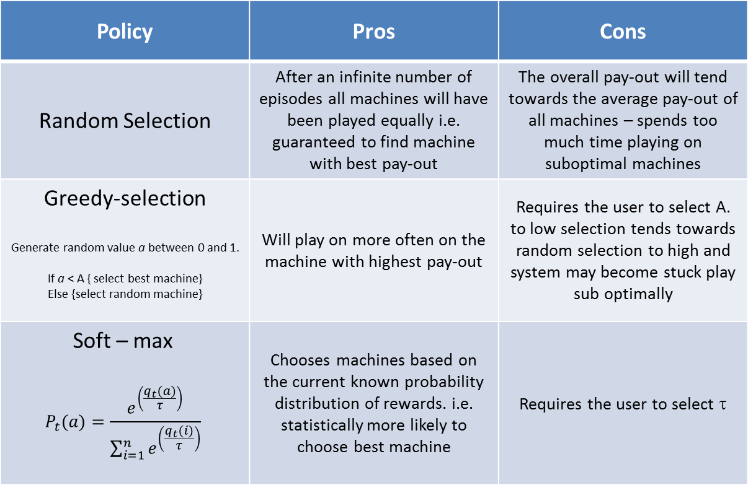
The N-bandit problem
Policy | Pros | Cons
Random Selection | After an infinite number of episodes all machines will have been played equally i.e. guaranteed to find machine with best pay-out | The overall pay-out will tend towards the average pay-out of all machines – spends too much time playing on suboptimal machines
Greedy-selection Generate random value a between 0 and 1. If a < A { select best machine} Else {select random machine} | Will play on more often on the machine with highest pay-out | Requires the user to select A. to low selection tends towards random selection to high and system may become stuck play sub optimally
Soft – max $$P_{t}(a)=\frac{e^{\left(\frac{q_{t}(a)}{τ}\right)}}{\sum_{i=1}^{n}{e^{\left(\frac{q_{t}(i)}{τ}\right)}}}$$ | Chooses machines based on the current known probability distribution of rewards. i.e. statistically more likely to choose best machine | Requires the user to select τ

Slide 38
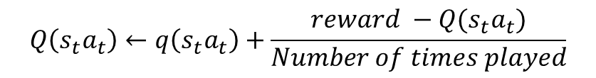
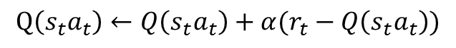
The N-bandit problem
Playing on a machine does not result in any more actions so can be thought of as a terminal state
The Q-Learning equation can be reduced to:
Alternatively in the case of this problem we could also use the cumulative frequency
$$Q\left(s_{t}a_{t}\right)←Q\left(s_{t}a_{t}\right)+α(r_{t}−Q\left(s_{t}a_{t}\right))$$
where
α = Learning rate
New Value
Old Value
Reward
Old Value
$$Q\left(s_{t}a_{t}\right)←q\left(s_{t}a_{t}\right)+\frac{reward −Q(s_{t}a_{t})}{Number of times played}$$

Slide 39
The N-Bandit problem - Results
Hyper Parameters
Number of machines | 10
Number of games | 100 000
Learning rate | 0.01
τ | 0.9

Slide 40


So where do neural networks fit in?
Remember that neural network can associate any input to an output
The input is a given state experienced by the agent.
The output becomes the learnt action to carry out on this state
Input layer
Hidden layer
Output layer
ANN
State
Selection
Action

Slide 41
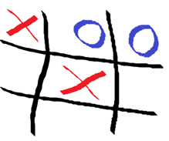
Q learning Tic-Tac-Toe
Hidden Layer(s) of n Neurons
0
1
1
0.5
0
0.5
0.5
0.5
0.5
0
0
0
0.7
0
0.54
0.67
0.43
0.99
The outputs form the network can be thought of as how optimal a given board position (move) is.
Move selection can be carried out using and method
Impossible moves may need to be artificially set to 0
Note:
Here I’m sticking with a sigmoid activation function hence the inputs must be scaled between 0 and 1.

Slide 42
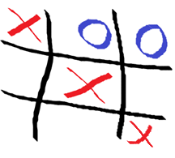
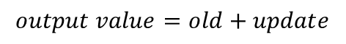
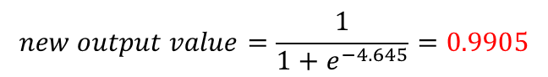
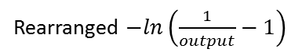
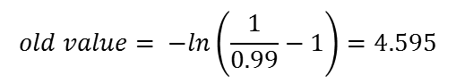
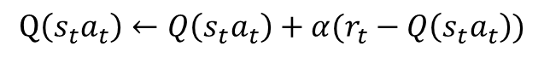
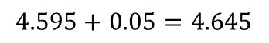
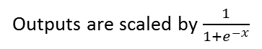
Q learning Tic-Tac-Toe
Old
Output
New
Output
$$old value= −ln\left(\frac{1}{0.99}−1\right)=4.595$$
0
0
0
0.7
0
0.54
0.67
0.43
0.99
0
0
0
0.7
0
0.54
0.67
0.43
0.9905
$$update value=Learning rate\left(reward−old\right)$$
$$update value=0.01\left(10−4.595\right)=0.05$$
$$output value=old+update$$
$$4.595+0.05=4.645$$
$$new output value=\frac{1}{1+e^{−4.645}}=0.9905$$
Reward for terminal state
Win = +10
Loss = -20
Draw = 5
Note:
Outputs are scaled by $\frac{1}{1+e^{−x}}$
Rearranged $−ln\left(\frac{1}{output}−1\right)$
$$Q\left(s_{t}a_{t}\right)←Q\left(s_{t}a_{t}\right)+α(r_{t}−Q\left(s_{t}a_{t}\right))$$

Slide 43
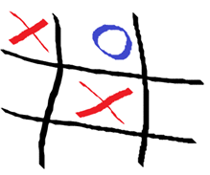
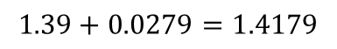
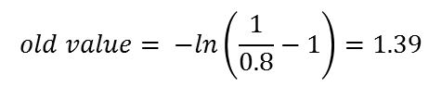
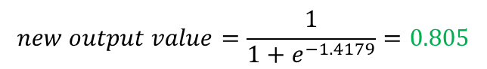
Q learning Tic-Tac-Toe
$$old value= −ln\left(\frac{1}{0.8}−1\right)=1.39$$
$$update value=Learning rate\left(γ∗Max−old\right)$$
$$update value=0.01\left(0.9∗4.645−1.39\right)=0.02$$
Old
Output
New
Output
Future
State
$$output value=old+update$$
$$1.39+0.0279=1.4179$$
0
0
0.54
0.7
0.8
0.23
0.44
0.43
0.1
0
0
0.54
0.7
0.805
0.23
0.44
0.43
0.1
0
0
0
0.7
0
0.54
0.67
0.43
0.9905
$$new output value=\frac{1}{1+e^{−1.4179}}=0.805$$
Note:
Outputs are scaled by $\frac{1}{1+e^{−x}}$
Rearranged $−ln\left(\frac{1}{output}−1\right)$
$$Q\left(s_{t}a_{t}\right)←Q\left(s_{t}a_{t}\right)+α(r_{t}+γ∗maxQ\left(s_{t+1}a_{t}\right)−Q\left(s_{t}a_{t}\right))$$

Slide 44
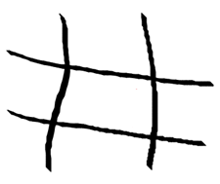
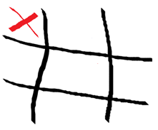
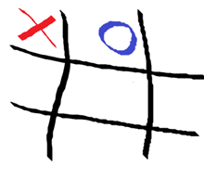
Q learning Tic-Tac-Toe
0.5 | 0.8004
0.5 | 0.45
0.5 | 0.47
0.5 | 0.51
0.5 | 0.11
0.5 | 0.34
0.5 | 0.67
0.5 | 0.70
0.5 | 0.55
0 | 0
1 | 0
0.5 | 0.54
0.5 | 0.70
0.5 | 0.805
0.5 | 0.23
0.5 | 0.44
0.5 | 0.43
0.5 | 0.10
0 | 0
1 | 0
1 | 0
0.5 | 0.70
0 | 0
0.5 | 0.54
0.5 | 0.67
0.5 | 0.43
0.5 | 0.9905

Slide 45
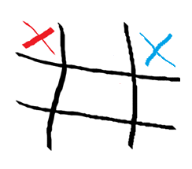
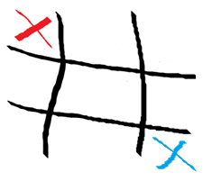
Q learning Tic-Tac-Toe
We can expand the number of training examples by taking into account symmetry – this should improve the speed at which the network learns.
Reflections
Note:
Duplicates need to be removed

Slide 46
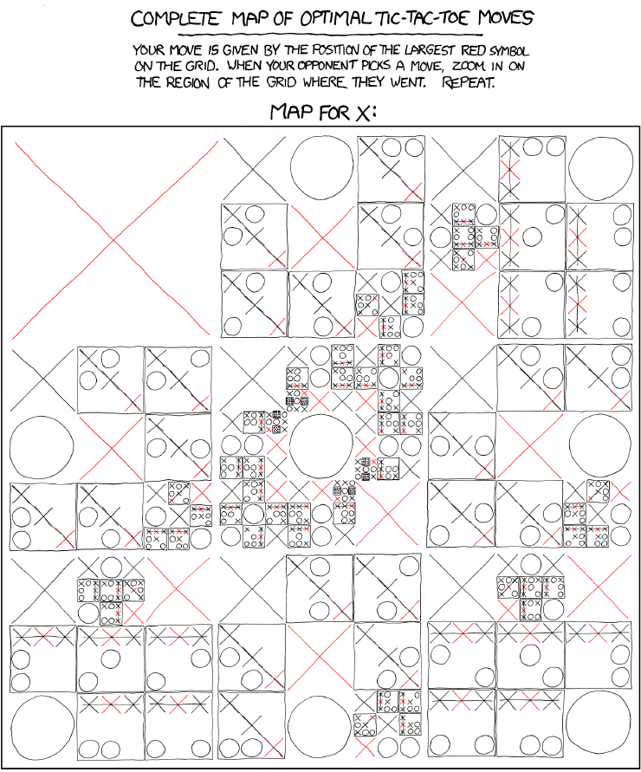
Hyper parameters - An exercise to those interested
Neural network
Number of hidden layers
No. of neurons per hidden layer
Learning rate
Momentum factor
Number of iterations
Q learning
Learning rate
Discount rate
Rewards
τ
https://imgs.xkcd.com/comics/tic_tac_toe.png

Slide 47

Thank you all for listening
Any questions?

